Slide 1
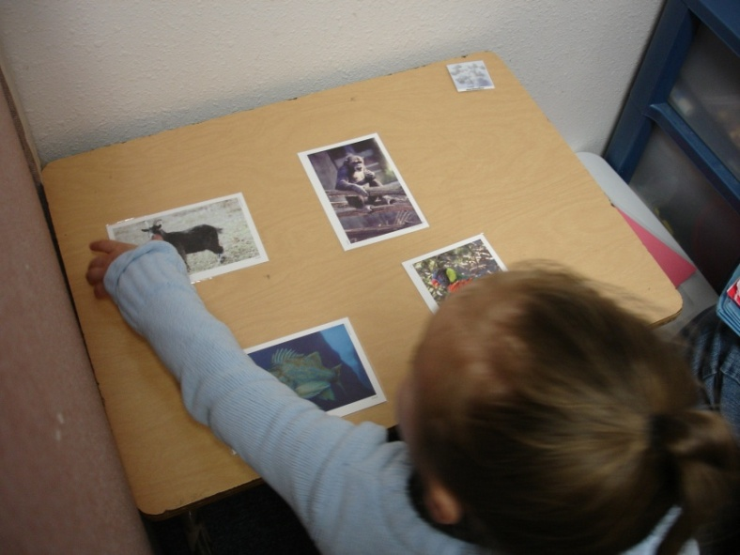
trategies for eaching based on utism esearch
STAR
S
T
A
R

Slide 2
The Research
Oregon Outcomes Study 1997-present
Portland State University in conjunction with Oregon Department of Education and EI/ECSE Regional Programs conducted the study
67 students with autism were followed in original cohort
Outcome data is collected by observation of performance,
surveying of parents and teachers, and standardized
assessments
Students’ social interaction, language, communication,
cognitive, adaptive behavior, and academic skills/abilities
are being measured and monitored

Slide 3
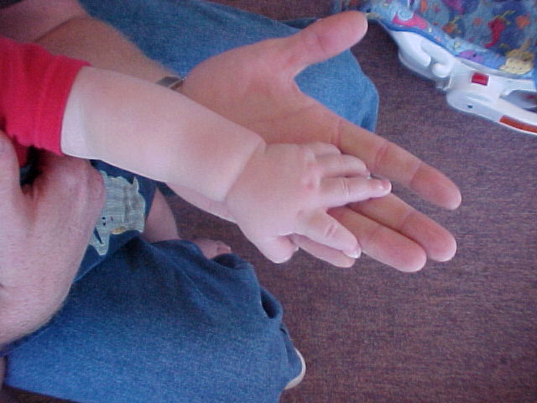
Service Models 2002 and Beyond
Earlier Identification
Intensive Classrooms
At a Variety of Age Levels
ASD Grants
ASD Competencies
State Guidelines
Student Growth
National Study of Instructional Strategies

Slide 4
The Data
www.autismstudy.pdx.edu

Slide 5
S.T.A.R. Program Overview Curriculum and Instructional Methods
Joel Arick, Ph.D., Lauren Loos, M.A., Ruth Falco, Ph.D. and John Gill, M.S.
(Portions of this information were taken from the STAR Program Manual, published by Pro-Ed, Austin, TX (Arick, Loos, Falco, and Krug, 2004) and is not to be copied without the author’s permission. This handout is to be accompanied with a live training. It is not intended to be a stand-alone document.)
This presentation was created with permission from the publisher for use with the Oregon Regional Autism Training Project and Outcome Study:

Slide 6
Terminology
PRT – Pivotal Response Training
FR – Functional Routines
DT – Discrete Trial

Slide 7
Student Learning Profiles
The First Step
Notes:
Review Profiles Components

Slide 8
Curriculum Content Areas
Level I
Receptive language concepts (DT)
Expressive language concepts (PRT)
Functional routines (FR)
Pre-academic concepts (DT)
Play and social interactions concepts (PRT/FR)

Slide 9
Curriculum Content Areas
Level II and Level III
Receptive language concepts (DT)
Expressive language concepts (DT)
Spontaneous language concepts (PRT)
Functional routines (FR)
Pre-academic concepts (DT)
Play and social interaction concepts (PRT/FR)

Slide 10
Teaching Strategies
Discrete trial training (DT)
Pivotal response training (PRT)
Functional routine instruction (FR)

Slide 11
Discrete Trial Training (DT)
Skills are taught in a logical sequence building on previously learned skills. Concepts taught are identified, then broken down into specific elements for instruction. Each session consists of a series of discrete trials, using a four-step sequence:
(a) instructional cue
(b) student response
(c) consequence
(d) pause

Slide 12
Discrete Trial Training (DT)
Strategy | Cue | Response | Consequence | Pause
Application | Teacher provides instructional cue | Student responds | Teacher praises and gives child a positive reinforcer | There is a pause
Example | Teacher says, “Do this” and pushes car. | Student pushes car. | Teacher praises student and gives student a reinforcer. | Student uses reinforcer and teacher pauses before next cue

Slide 13
Pivotal Response Training (PRT)
PRT is also based on the four–step sequence: cue, student response, consequence and pause. Trials within PRT are incorporated into the environment in a function context. During PRT the student chooses the activity or object, and the reinforcer is a natural consequence to the behavior.

Slide 14
Pivotal response training (PRT)
Strategy | Cue | Response | Consequence | Pause
Application | Student indicates interest, teacher withholds item or activity | Student responds | Student gets item | There is a pause
Example | Student reaches for car, teacher withholds and says, “car”. | Student imitates the word car. | Teacher gives student access to car | Student plays with car

Slide 15
Functional Routines Instruction (FR)
Functional routines are predictable events that involve a chain of behaviors. Routines are associated with a functional outcome. Some common routines in which all children engage are; using the restroom, arriving, and eating a snack. The outcome of a routine usually serves as the reinforcer for completing the routine.

Slide 16
Functional routine instruction (FR)
Strategy | Cue | Response | Consequence | Pause
Application | Environment provides a natural cue | Student does each step needed to complete the activity | Student gets natural outcome of activity | Student focuses on next routine
Example | Student’s bus arrives, door opens. Others start to get off bus | Student gets off bus, goes in correct direction, enters building, goes to class, puts materials away | Student is inside class with others and has activities to do. Teacher offers praise | Student transitions to next routine

